Slide 1
Fresh Basket
Eat Well, Live Well With Fresh Basket…!
Group No. -:70
Team Members :-
1. Deepak Pramod Dhake - 230341220058
2. Tanishq Pandurang Kadam – 230341220081
Guided By :- Mrs.Manjiry Deshpande

Slide 2
Introduction
Online Shopping of Fresh Food opens up a new world of options. Users won’t have to go from store to store to hunt for fresh food. They won’t have to worry about wondering whether their food is organic or inorganic. They will be able to refill their fridges in just one click, all while sitting at home.
Our system offers one stop solution to all fresh food needs. Users can log into their accounts and then they will be taken to produces offered by the farmer.

Slide 3
Objective
The Fresh Basket is about farmers and their showcased merchandise.
It is about connecting farmers directly to the customers, there by cutting the middle man. This ensure that customers get fresh foods at a very cheap price.
This also ensure that all the farmers get a fair chance at gaining customers so that they don’t have to rely on any middle man.
Customer can pick what foods they want to order and add to the cart.

Slide 4
Scope :
“Fresh Basket” aims to deliver a web-based application that hosts-:
Wide collection of the food-items that users can browse through. Users can place orders and make payment.
They can update their profile, add delivery address .They can view their order history as well.
Admins can manage various product details like stock, price, adding new products, and categories etc.
Only admin can add farmers. Admins can even delete users and/or farmers, if the need arises.
Admin can manage all the products , Farmers , category.
Admin can view the order placed by user.

Slide 5
Technologies Used-:
I .Front End-:
BootStrap
JavaScript
React
ii. Back End-:
Spring Boot
Spring Data JPA
Hibernate
j2EE
iii. Database Management System
MySQL

Slide 6
Software and Hardware Specifications-:
Client side:
Server side:
Web Browser | Google Chrome or any compatible browser
Operating System | Windows or any equivalent OS
RAM | 2 GB and above
Stable Internet Connection
Server-side Language | J2EE(Spring, Hibernate)
Operating System | Windows 10
Database Server | MySQL

Slide 7
Functionalities-:
Admin side Functionalities-:
Login & Logout – Similar to customers, admins can login & logout to access their account.
Add / Update Farmers –Only admin is responsible for adding and updating
the details of farmer.
Delete Farmer –The admins can delete a farmer account if they need to for any
purpose.
Add New Category – Admins can add category.
Delete Category – Admins can remove category.
Add New Products – Admin can add new product with details as stock, price,
name, quantity, image, category, etc.

Slide 8
Admin Side Functionalities-:
Delete Category – Admins can remove category.
Add New Products – Admin can add new product with details as stock, price, name, quantity, image, category, etc.
Manage Products– Admin can update the product details.
View Users – Admin can view all registered users.
Delete User – Admin can delete a user if need arises.
View order details – Admin can view order details for all users.

Slide 9
Functionalities-:
User Side Functionalities-:
Browse – Customers can browse the homepage to explore the entire products available.
Register, Login & Logout – New customers can register on the site.
Existing customers can then login to access their account information and logout when the account is not in use.
View & Update Profile – When logged in, customers can view their profile and update their details.
Update Delivery Address – When purchasing listed items, a customer can update delivery addresses which they can associate with their account.

Slide 10
User Side Functionalities-:
Add to Cart & Place Orders – If customers finds the food item of their choice they can save the item in the cart until they decide to purchase it. If at any point they want to cancel certain item they can simply remove it from the cart on one click. When they wish to purchase it, they can place orders for those items by selecting a delivery address on their account and pay the bill.
f. View Order History – Every customer can view their order history in order to get an idea about their past spending. Also the customer will get email notification for respective order details.

Slide 11
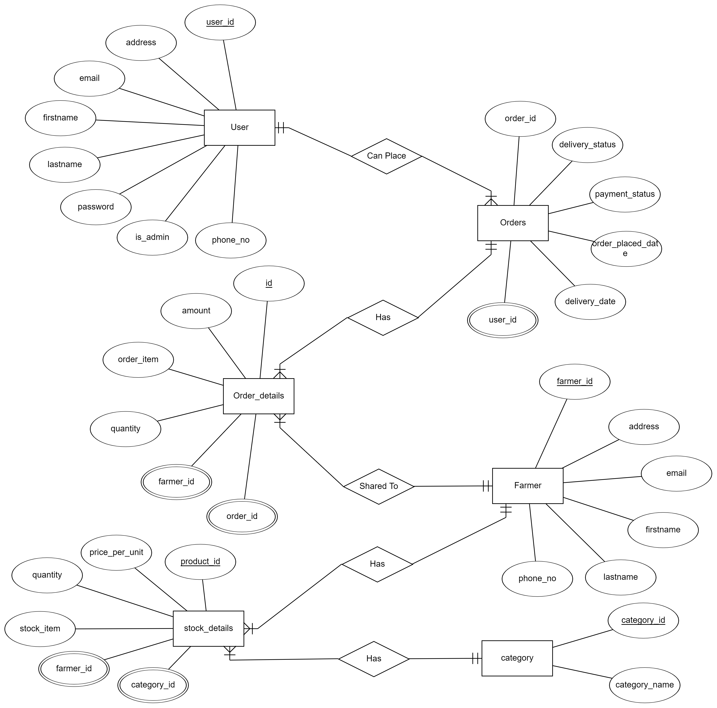
ER Diagram -:

Slide 12
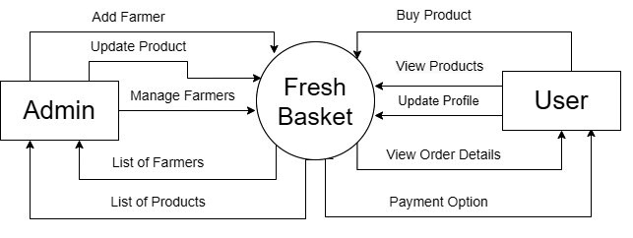
DFD Diagrams -:

Slide 13
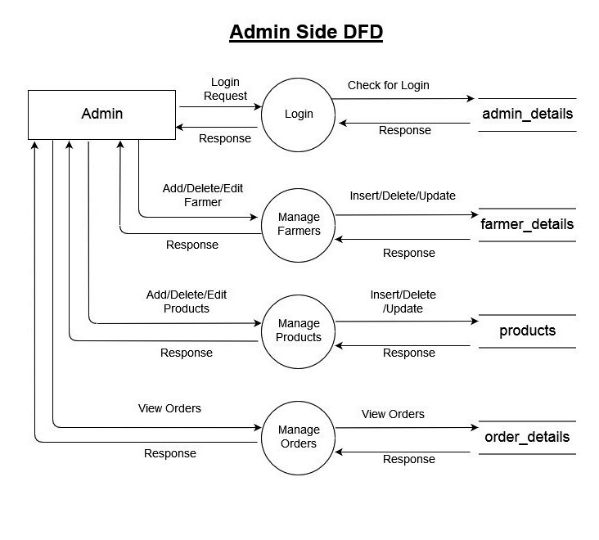

Slide 14
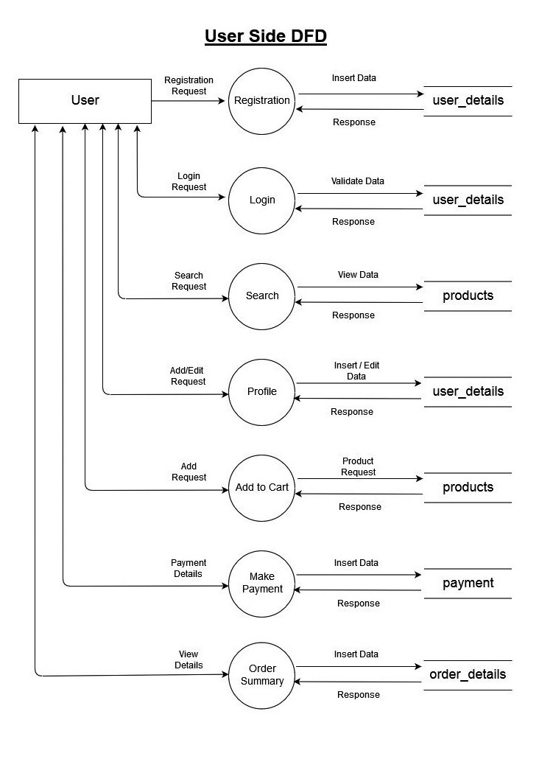

Slide 15
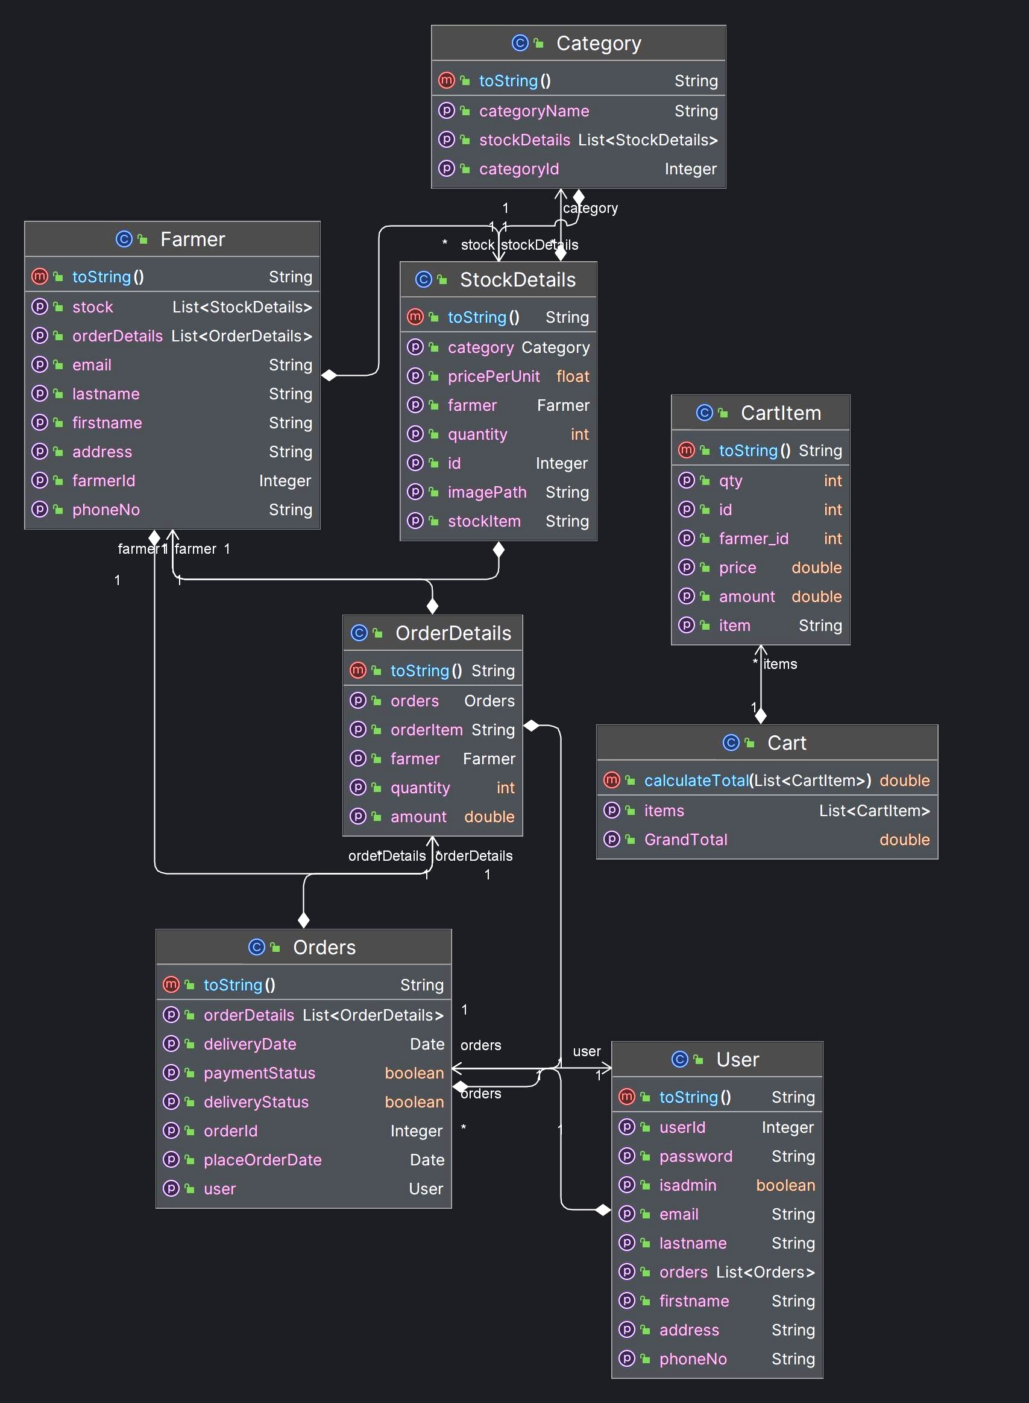
Class Diagram -:

Slide 16
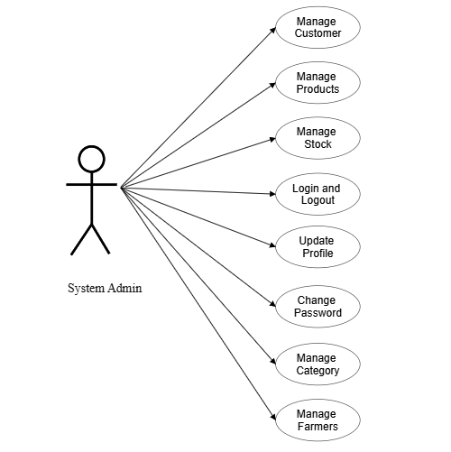
Use Case -:

Slide 17
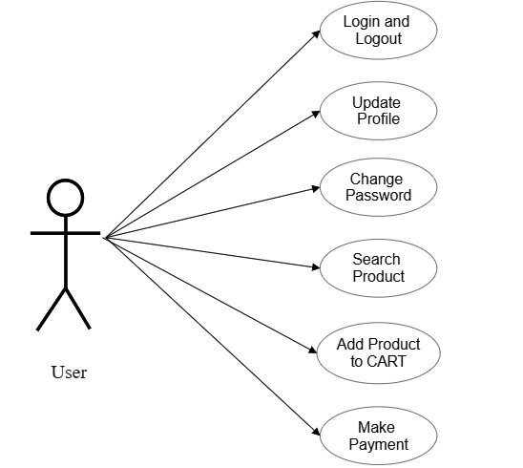

Slide 18
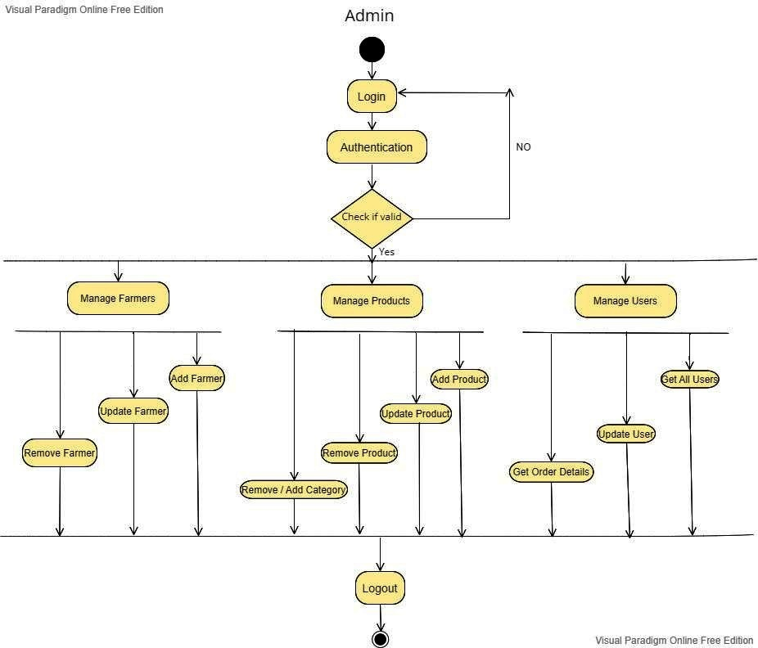
Acitivity Diagram -:

Slide 19
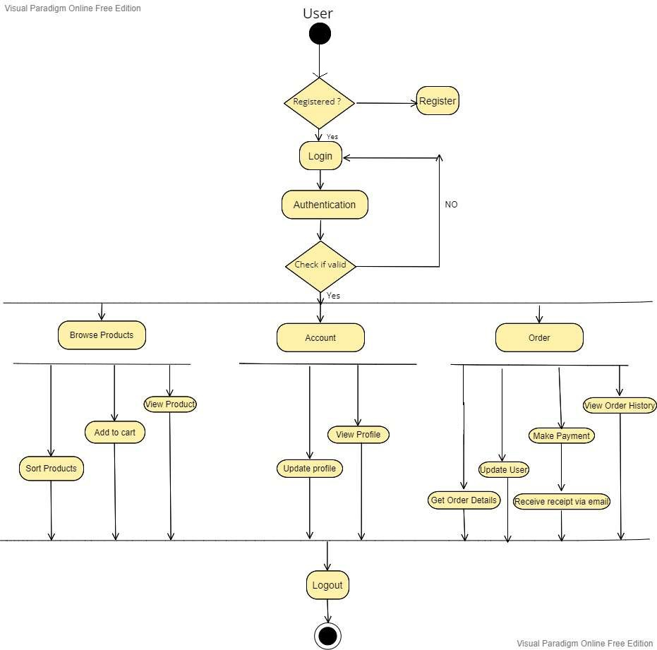

Slide 20
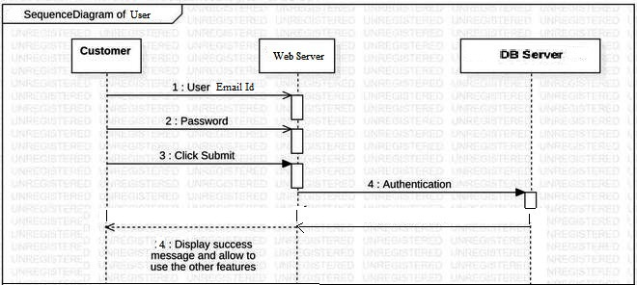
Sequence Diagram -:

Slide 21
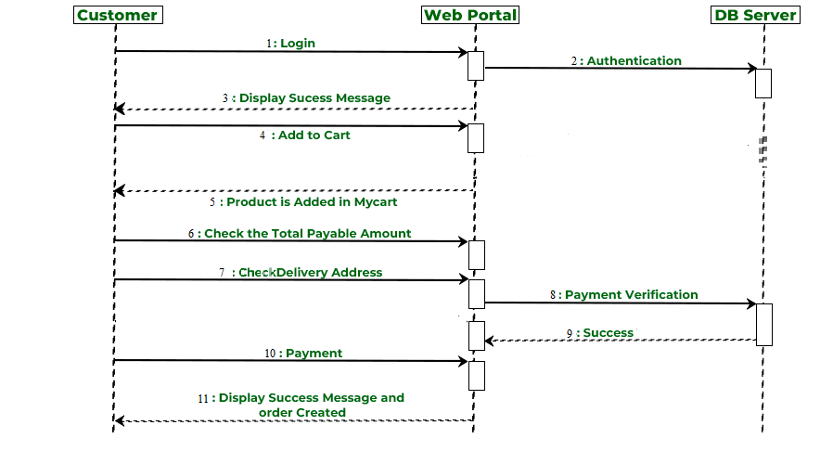

Slide 22
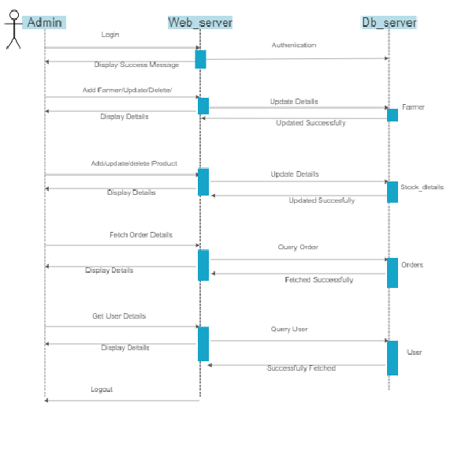

Slide 23
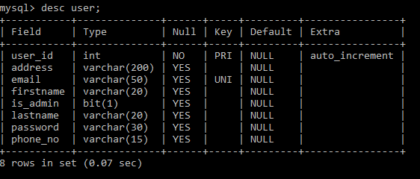
Database Screenshots -:
User Table -:

Slide 24
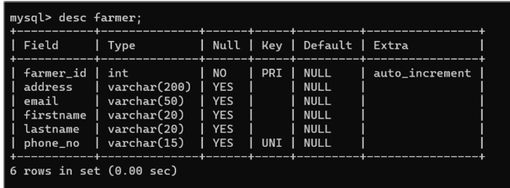
Farmer Table

Slide 25
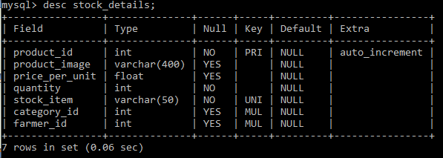
Stock Details Table -:

Slide 26
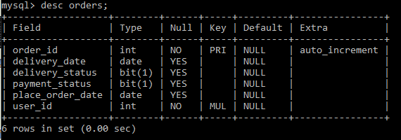
Orders Table -:

Slide 27
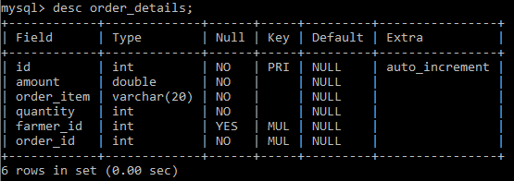
Order Details Table -:

Slide 28
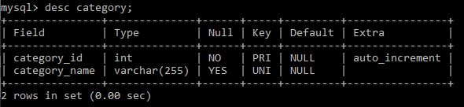
Category Table -:

Slide 29
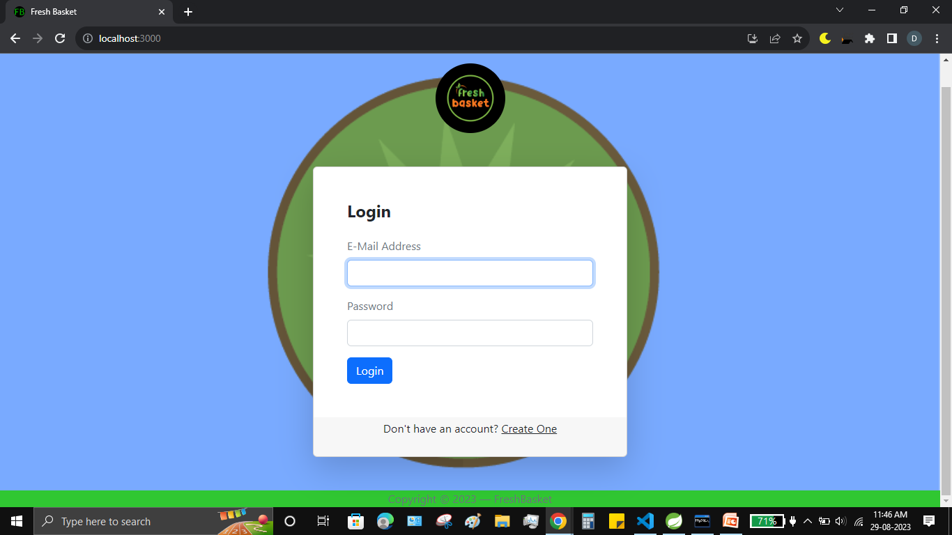
Project Screenshots -:

Slide 30
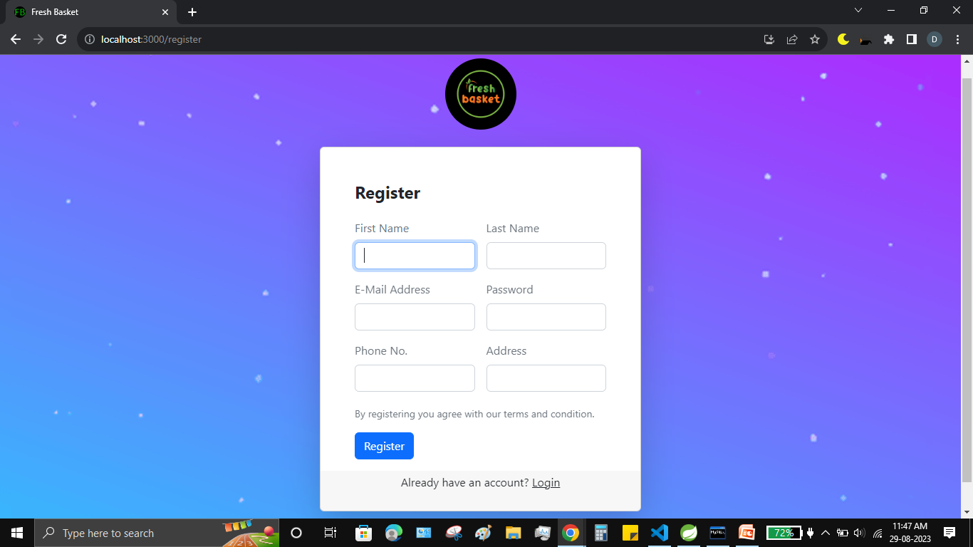

Slide 31
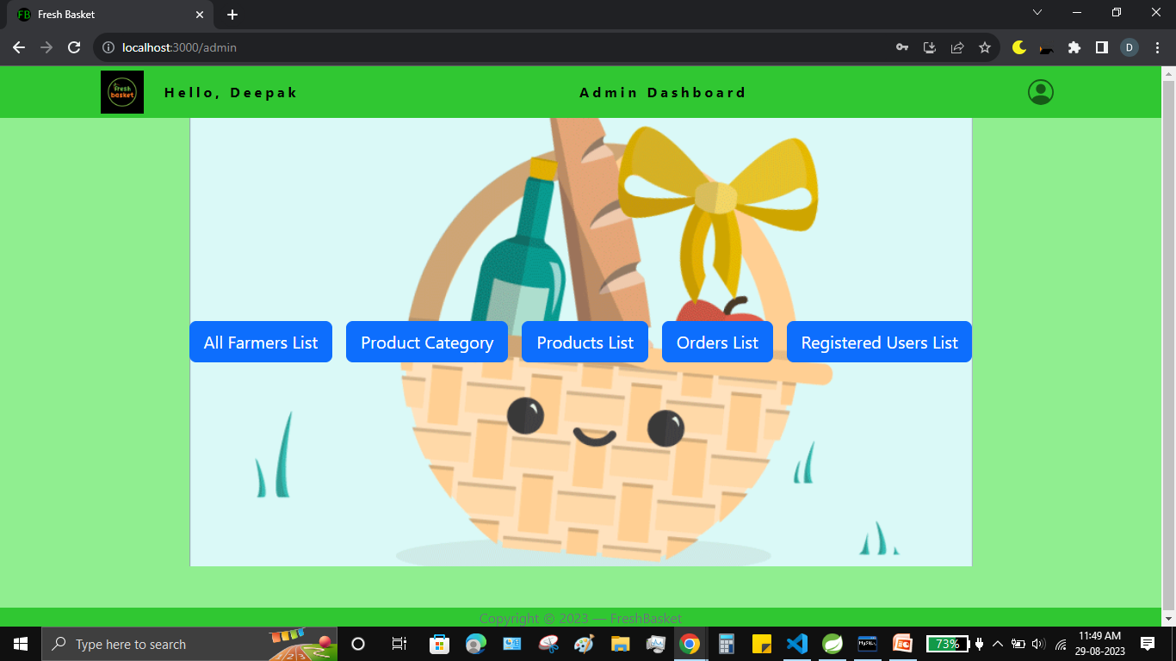

Slide 32
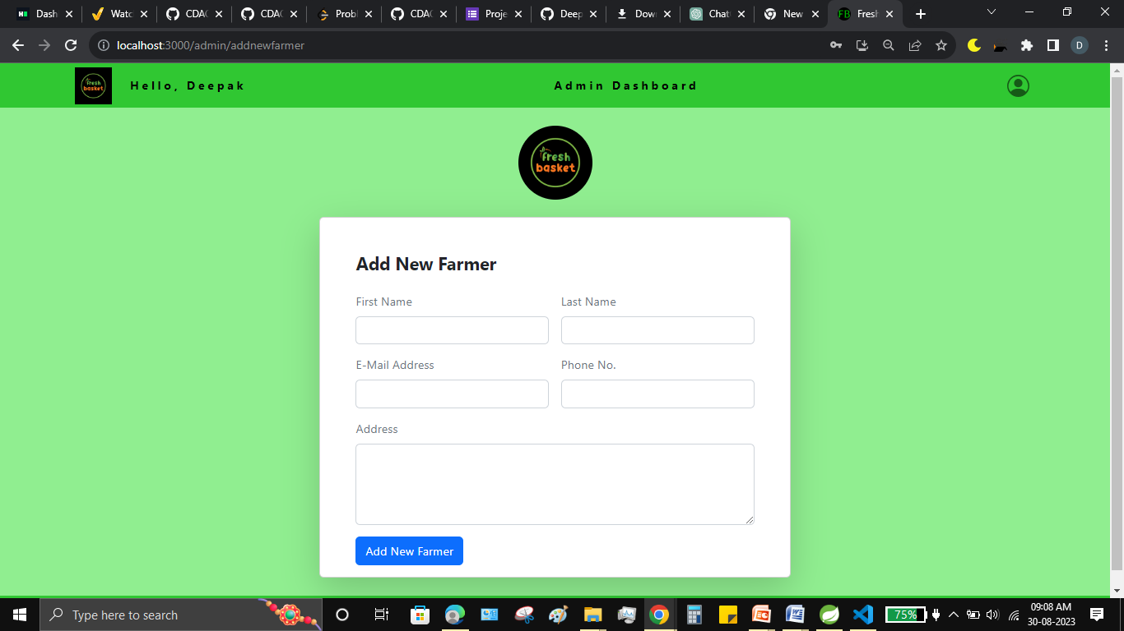

Slide 33
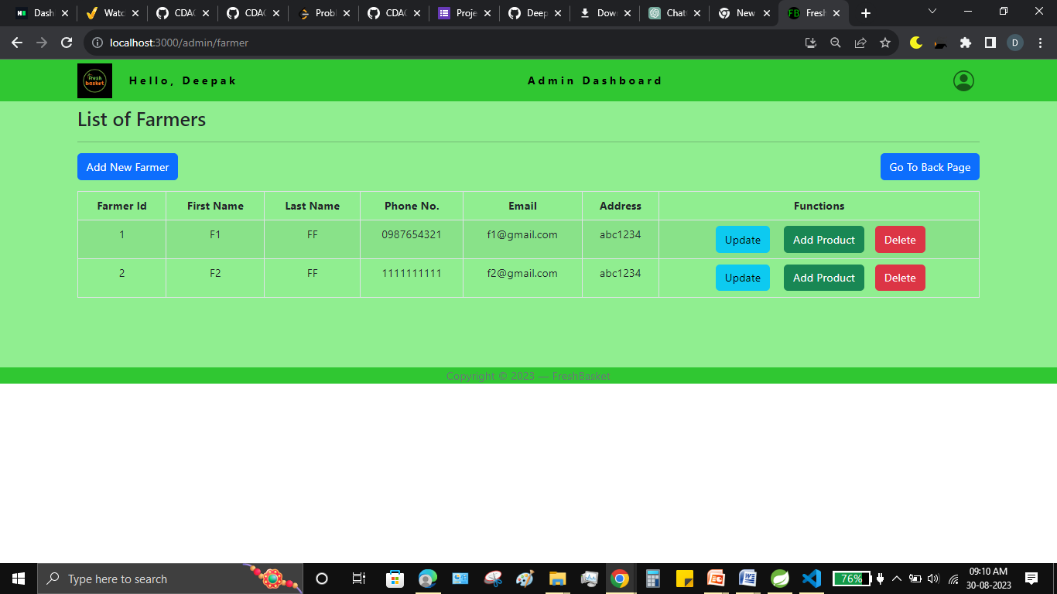

Slide 34
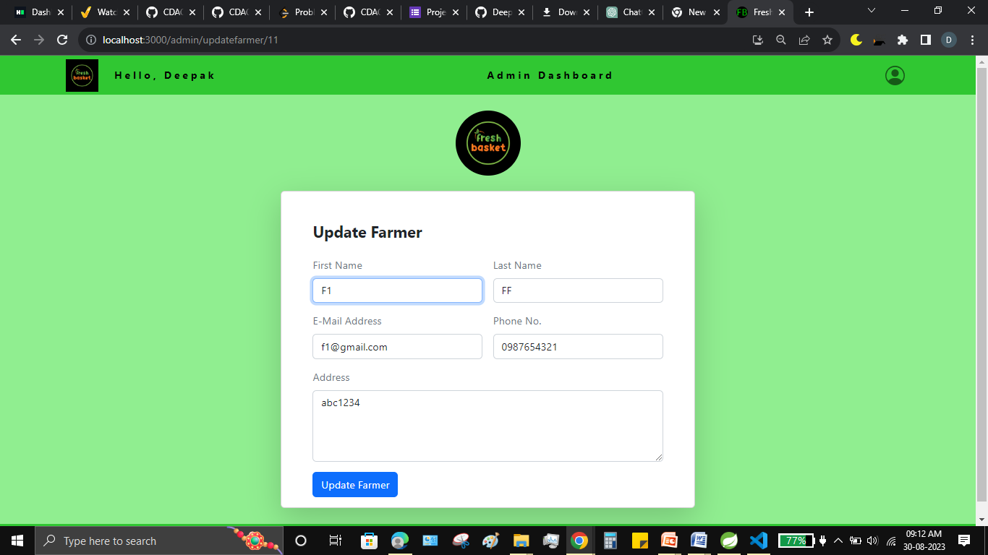

Slide 35
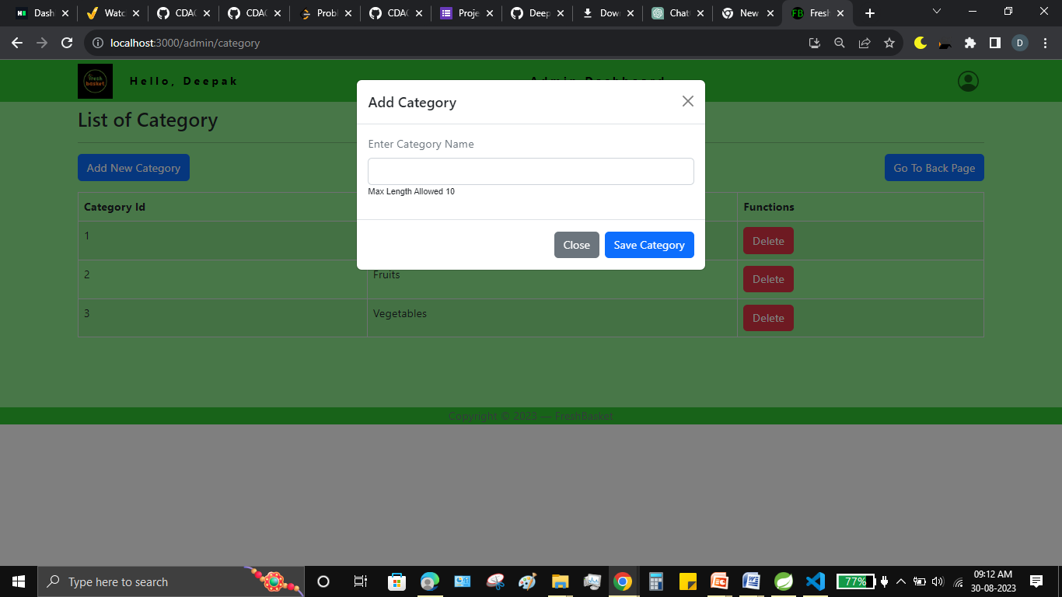

Slide 36
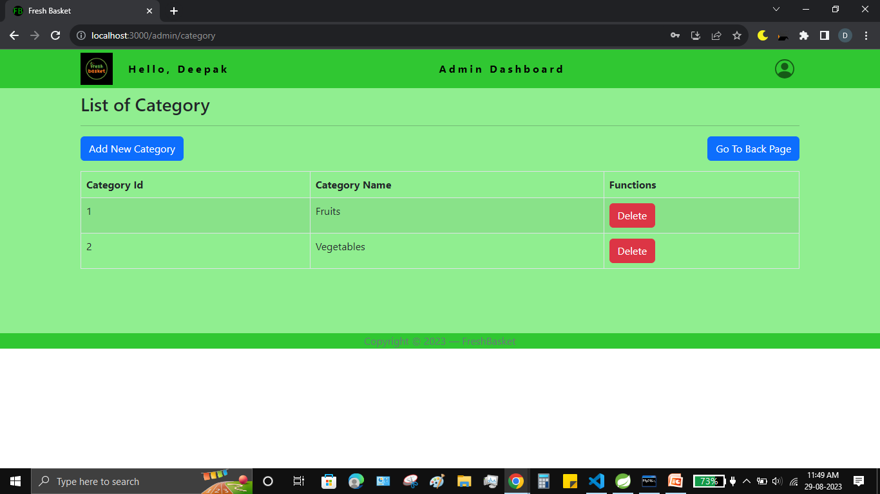

Slide 37
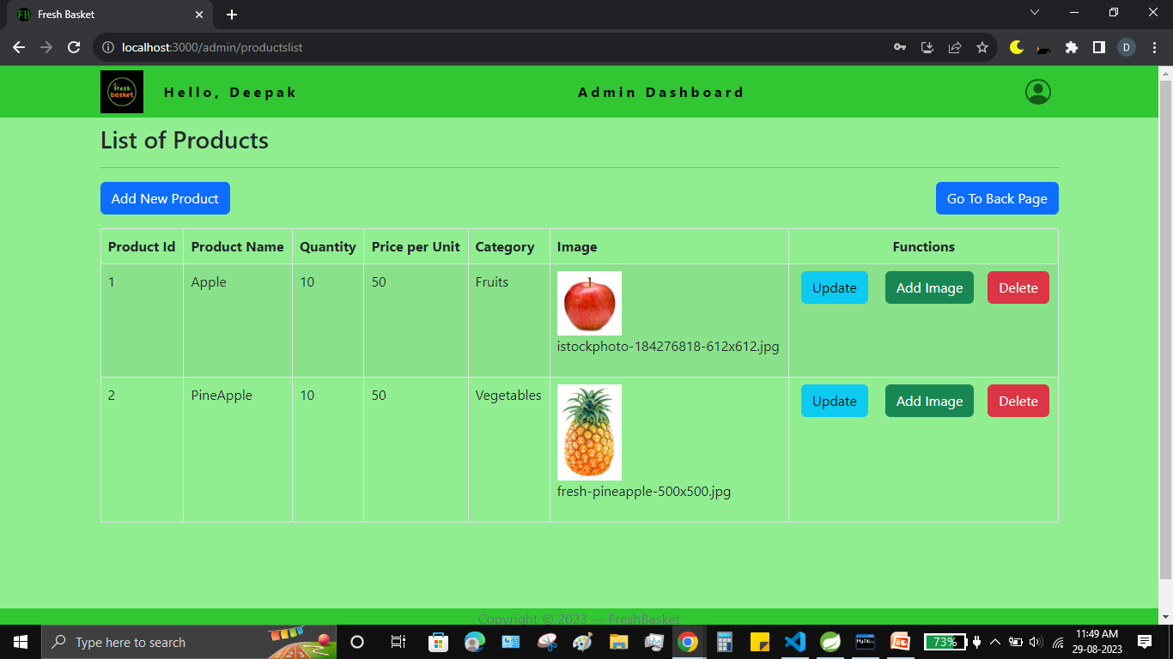

Slide 38
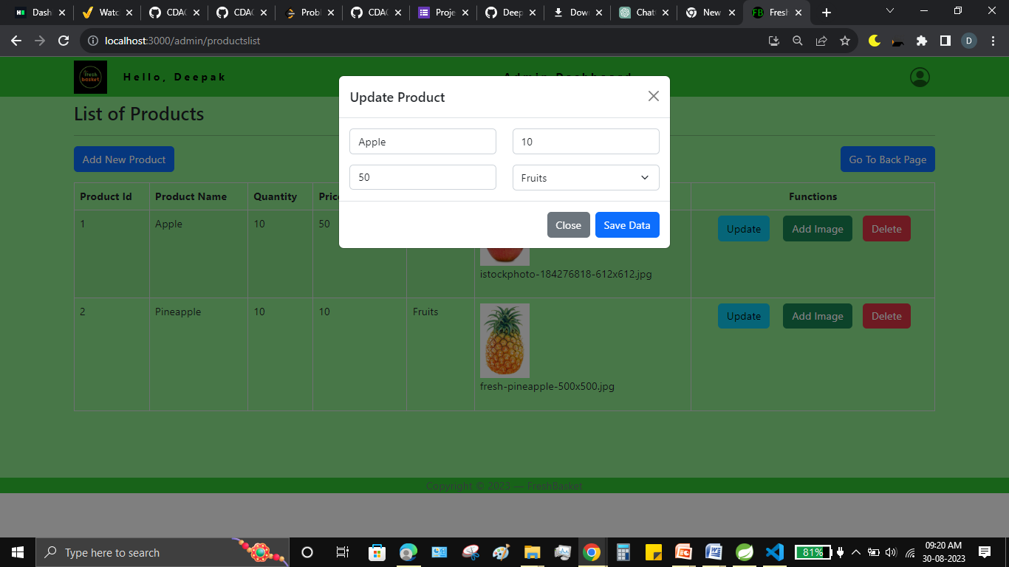

Slide 39
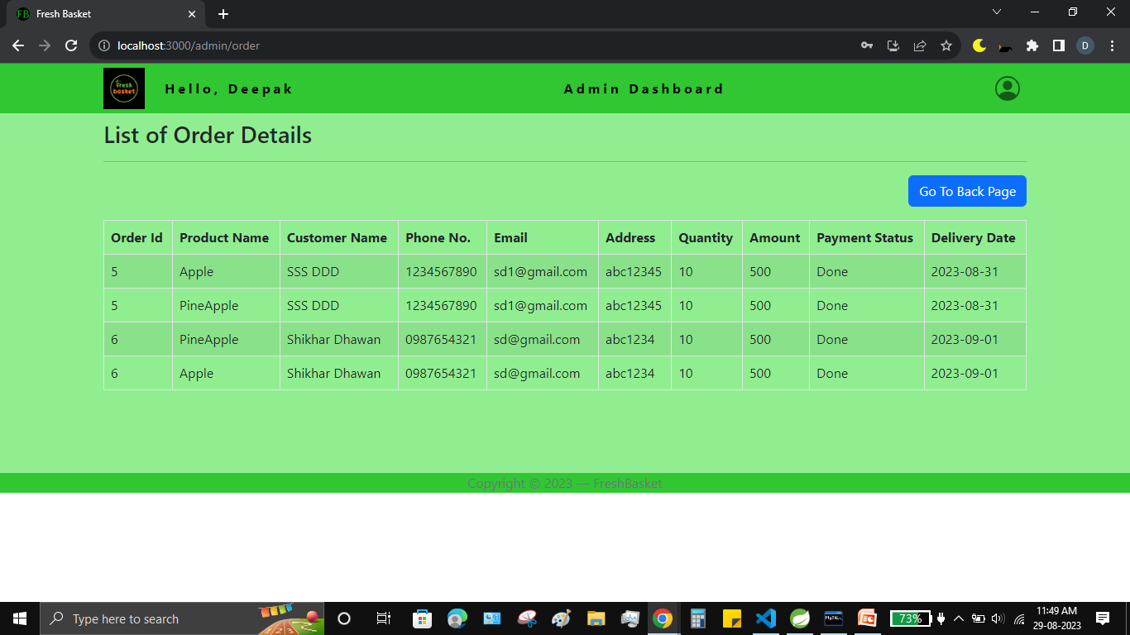

Slide 40
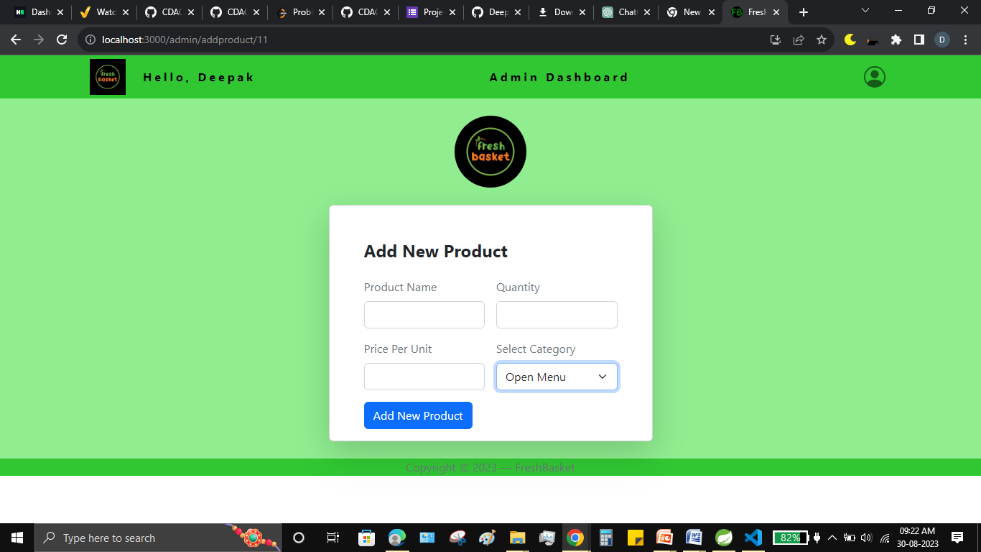

Slide 41
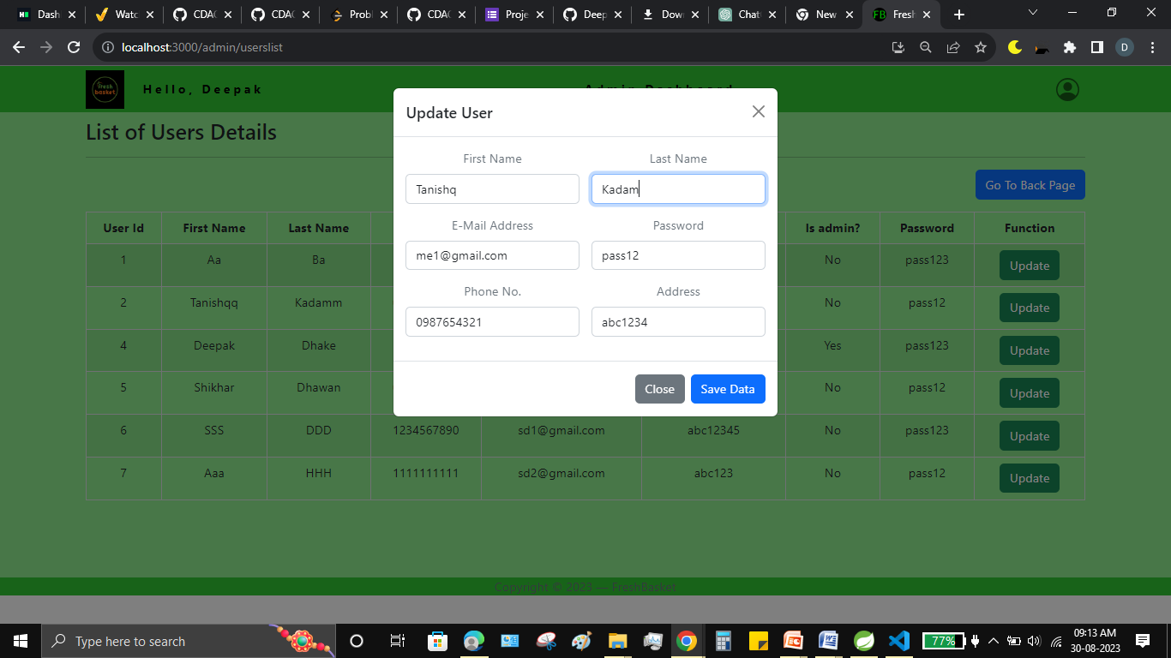

Slide 42
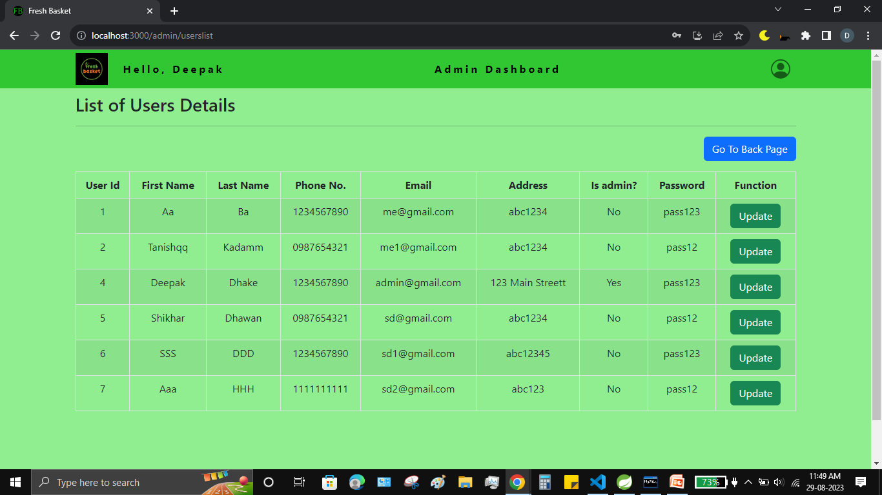

Slide 43
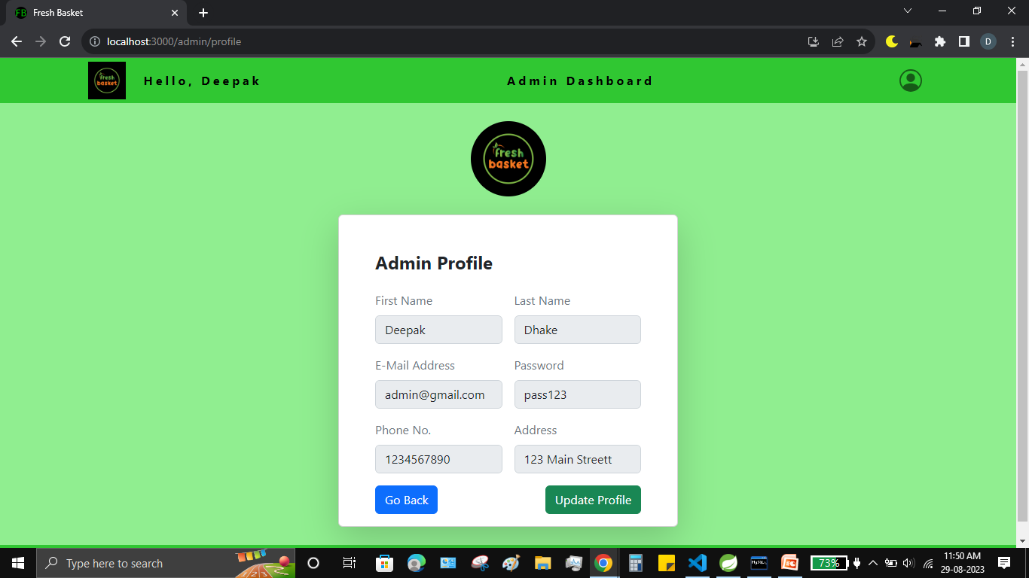

Slide 44
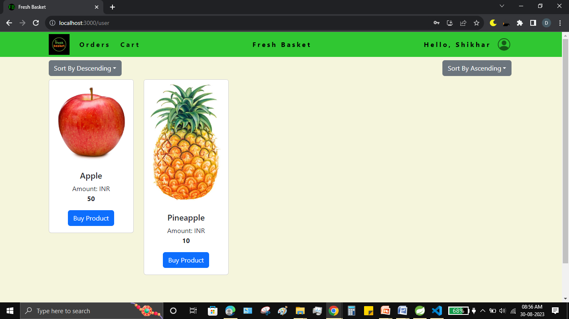

Slide 45
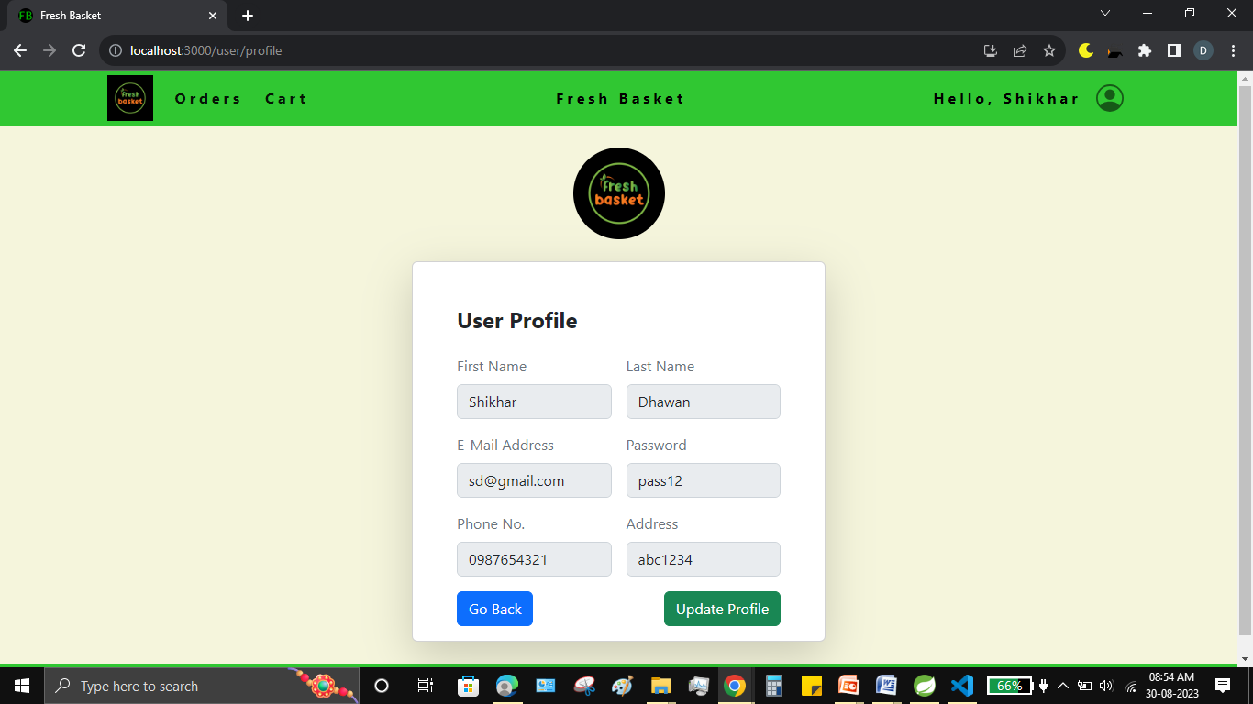

Slide 46
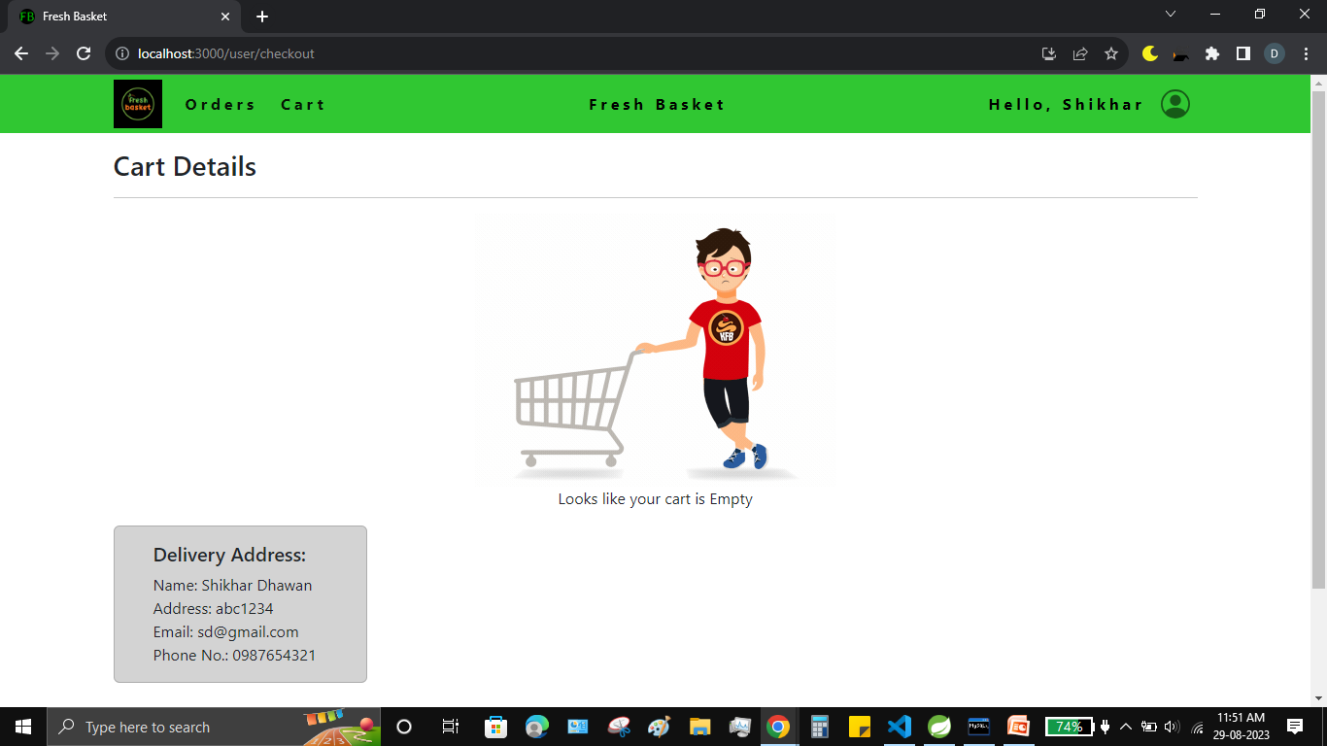

Slide 47
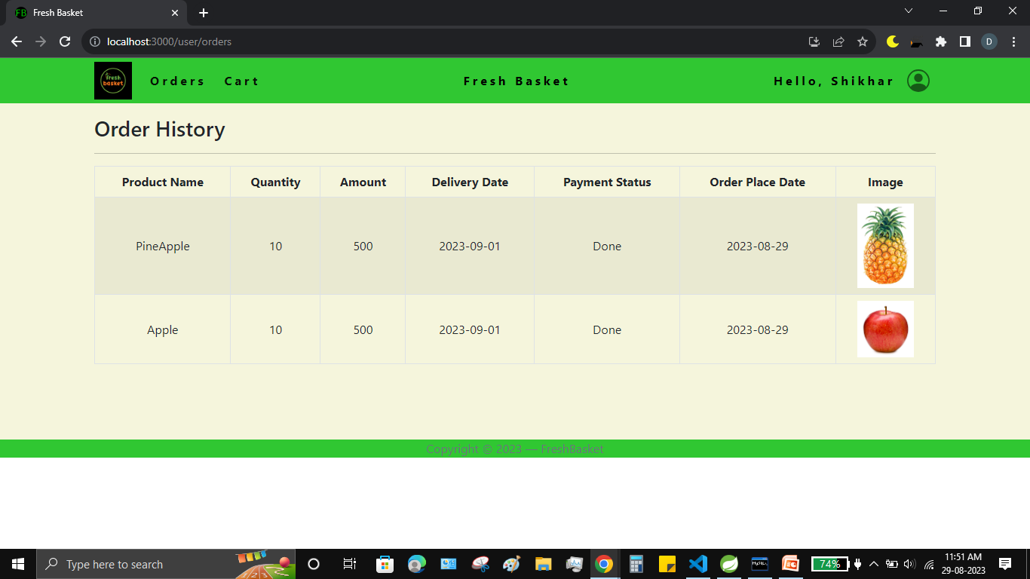

Slide 48
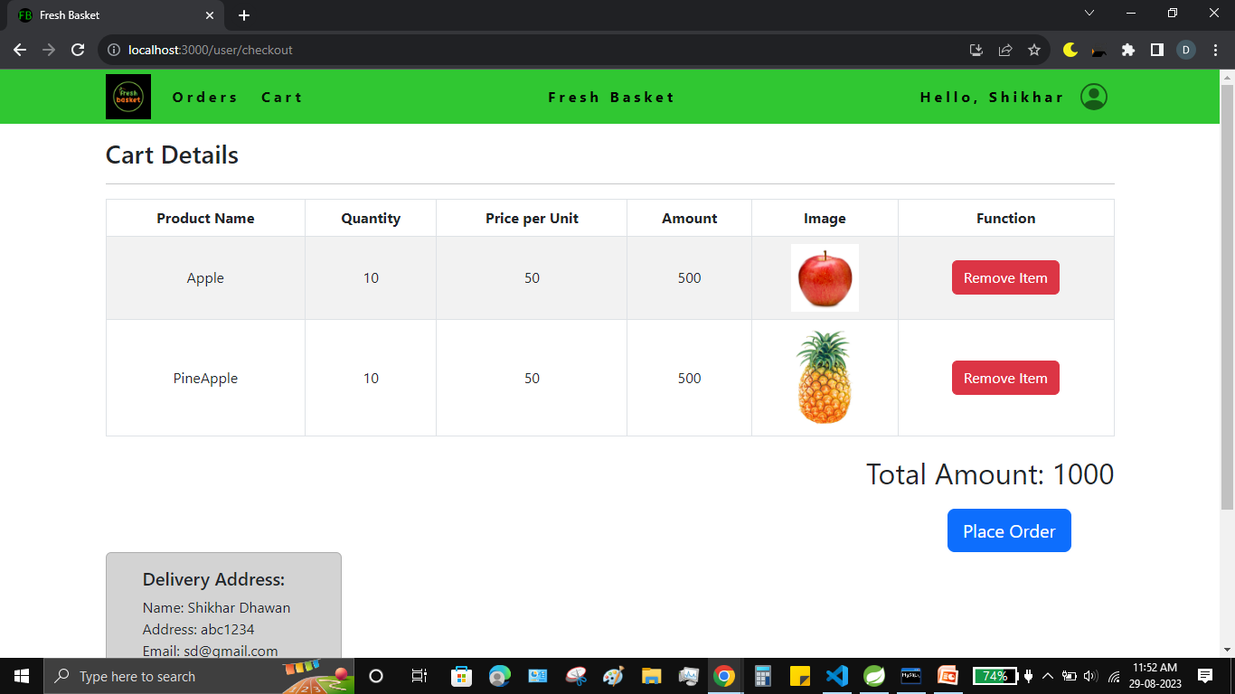

Slide 49
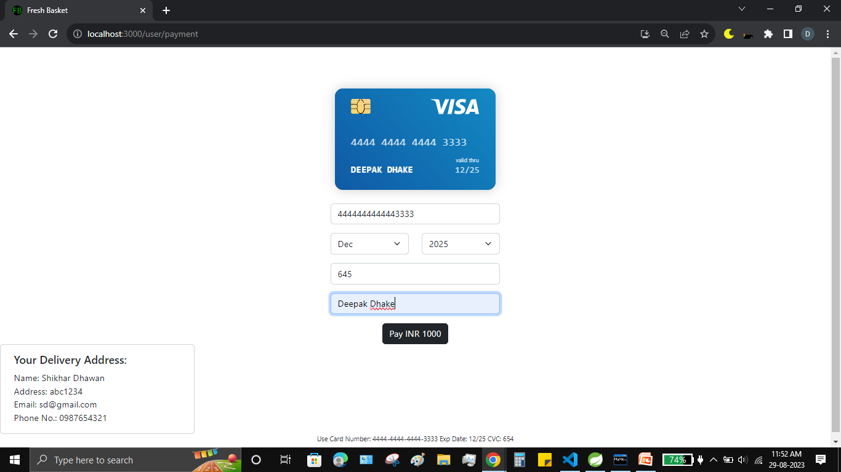

Slide 50
Conclusion :
In conclusion, “Fresh Basket” is an application would definitely be a good choice for any fresh-food merchandise trading Farmers that wishes to enter the online market. At the same time, it provides one-stop platform for Customers to purchase their daily need of merchandise directly from authenticated Farmers. We are confident that the numerous features and visually appealing look of application will certainly give a big boost to the Farmers.

Slide 51
References :
https://www.javatpoint.com/java-tutorial
https://www.geeksforgeeks.org
https://www.tutorialspoint.com/index.html
https://github.com/amaroteam/react-credit-cards
https://www.w3schools.com/

